Slide 1

Notes:
This is an optional module. It should be delivered after the two core modules: impulsivity and pressure.
Use these PowerPoint slides in conjunction with the resource sheet, which provides a module plan and a worksheet for students to use.
The module lasts 30 minutes.

Slide 2

Notes:
Tell students:
Most people have mobile phones and use them a lot. They have become a habit.
There is growing concern that people are addicted to their mobile phones.
It’s not so much of a problem when you’ve got time to use your phone.
It’s not good when you are supposed to be working, in a class, or doing something else.

Slide 3
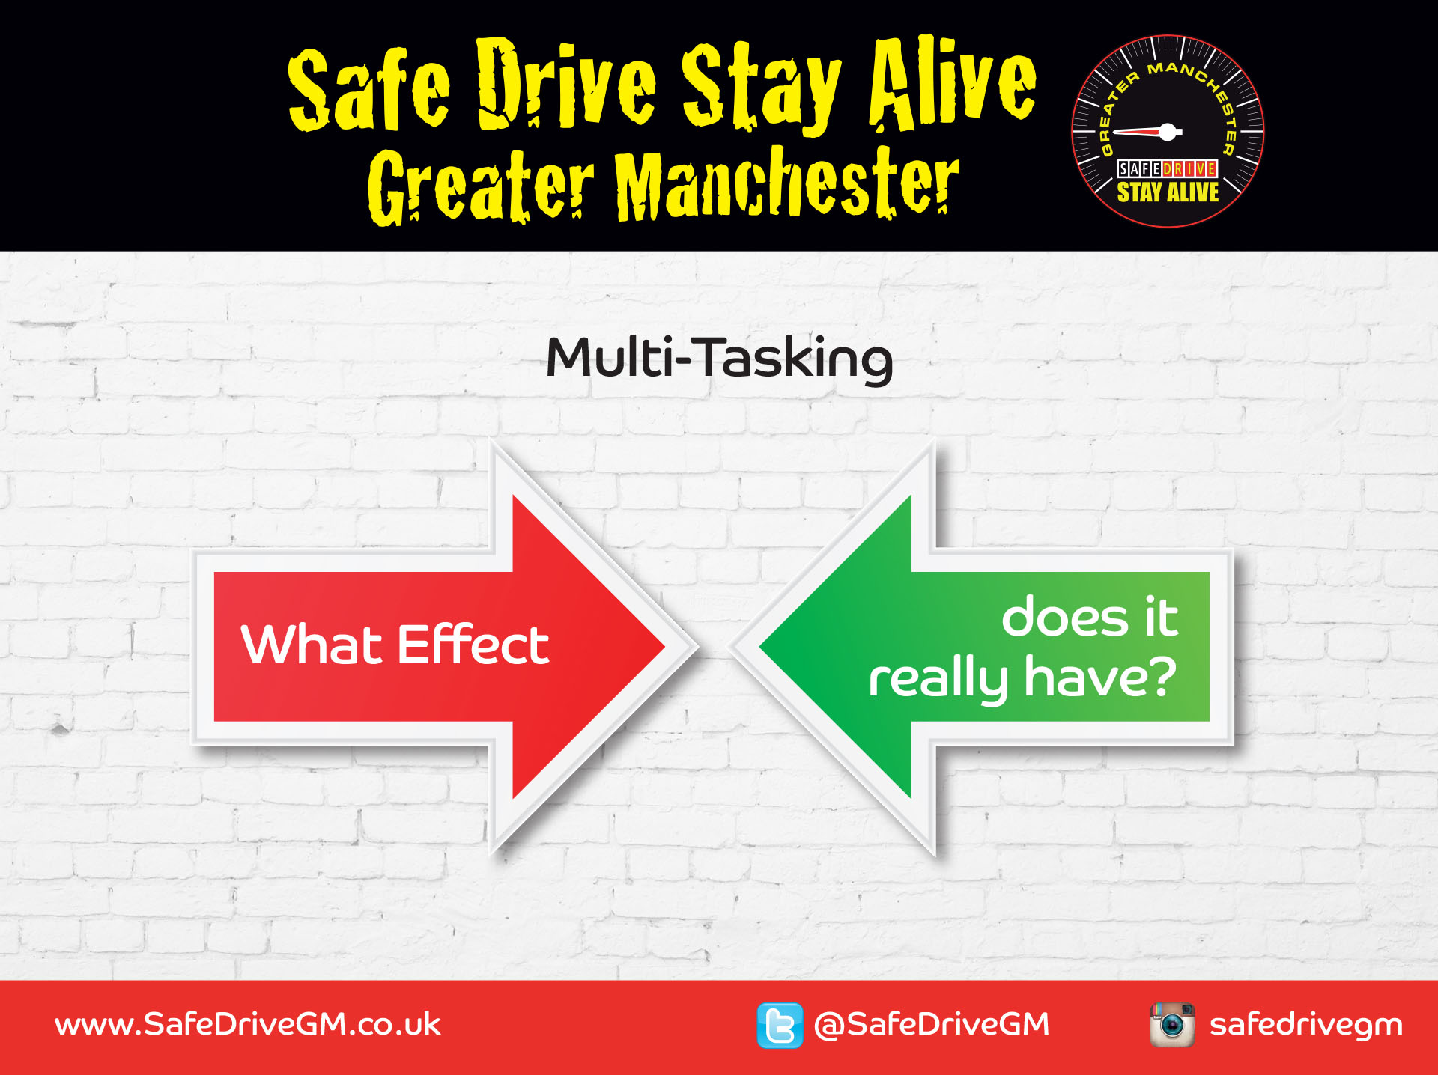
Notes:
Tell students:
Many people say that they’re really good at multitasking. But what always happens is that your concentration drops – you can’t do two things as efficiently as one.
Here’s a really simple example. All you need to do is to listen to the phone conversation and read the text at the same time.
Click onto the next slide then play the video.

Slide 4


Notes:
Tutor notes: This example shows that it’s not possible to do two things at the same time as well as you can one thing. The idea is that that nobody will be able to repeat back both what the text is AND what the conversation is, which demonstrates that you can’t do two things at once.
Tell students: Your task is to listen to what the people in the video are saying and also read the text that he is sending. What are they saying? What is the text?
Click on the video to play it.
Ask students: Can anybody repeat back both the conversation and the text?
Tell students: When you are driving all your attention needs to be on driving. You need to be fully aware of what is around you, such as that pedestrian who is about to step out into the road? You may think that you can text at the same time but you can’t. You’re four times more likely to crash. It’s not worth the risk.

Slide 5

Notes:
Tutor notes: This is a small-group activity that lasts around 10 minutes.
Tell students: In your groups, discuss Vicky’s case study and answer the questions on your worksheets.
Ask students: What did you discuss?

Slide 6
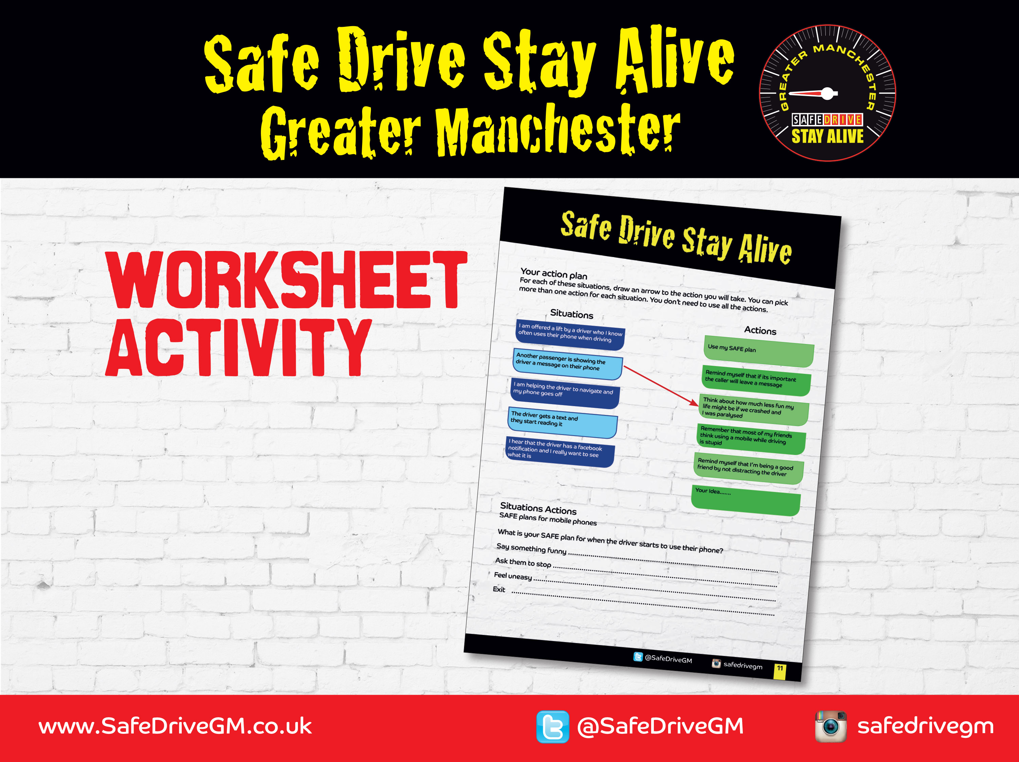
Notes:
Tutor notes: Allow around 10 minutes for these individual worksheet activities – both the action plan and the SAFE plan.
Tell students: On your worksheet you can see two sets of boxes. On the left side is a list of situations and on the right side is a list of actions. For each situation, draw an arrow to the action you will take. You can pick more than one action for each situation and you don’t need to use all the actions. There is also a box for you to write in your own ideas of the actions you will take.
Ask students: What did you put?

Slide 7
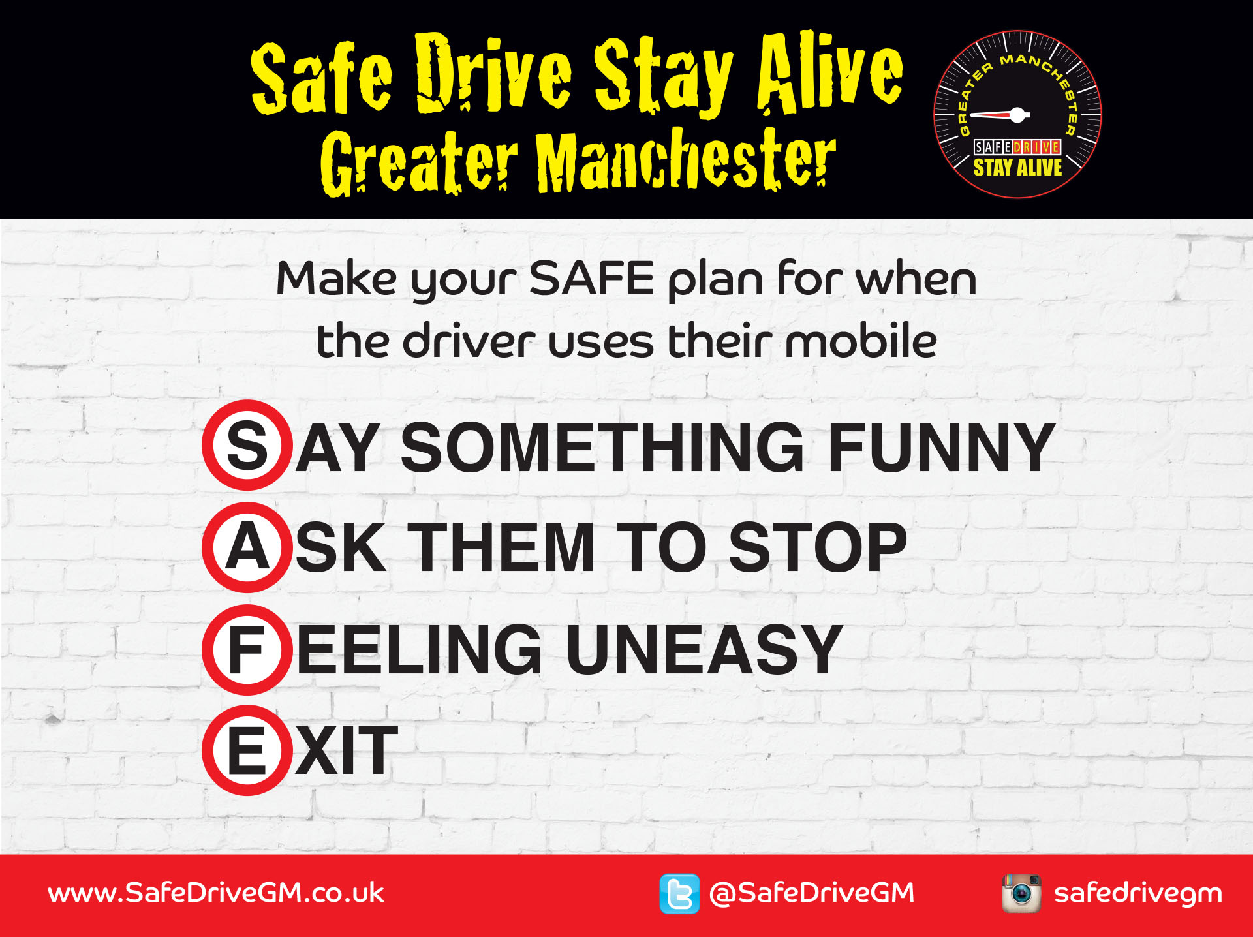
Notes:
Tell students: Remember the SAFE plan?
Make your SAFE plan for when you are in a car and the driver starts to use their mobile.
SAFE stands for:
Say something funny,
Ask them to stop
Feeling uneasy
Exit
Tutpr notes: The speech bubble appears on click.
Tell students: You use your SAFE plan to stop a small risk becoming a big one. If you think the situation is very risky or even dangerous, don’t wait – exit the situation straight away.

Slide 8
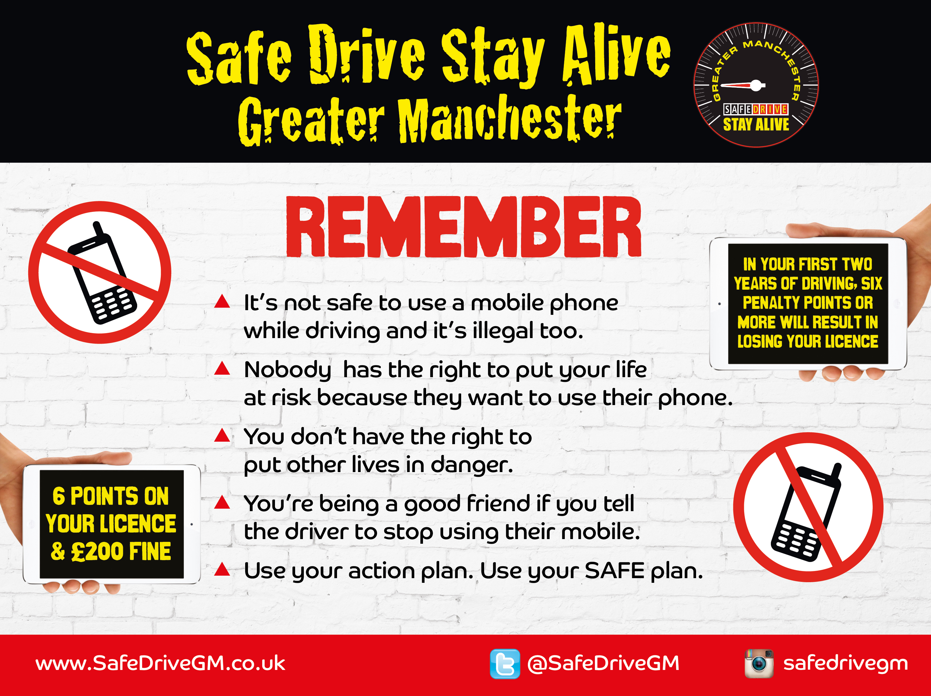
Notes:
Finish the session by summarising the key points.
Using a mobile phone is illegal and makes you four times more likely to crash.
Turn your mobile off or put it out of reach before you start driving.
Use your action plan to avoid being in a situation in which mobiles are putting your life at risk.
Use your SAFE plan if you are in a risky situation.

