Slide 1

Notes:
This is the first module. It covers how impulsivity can cause people to make bad choices.
Use these PowerPoint slides in conjunction with the resource sheet, which provides a module plan and a worksheet for students to use.
The module lasts 1 hour.

Slide 2

Notes:
Ask students: What do these have in common?
(eating a big slice of chocolate cake, going shopping and buying loads more than you mean to, going on gaming machines, messaging somebody you fancy – or maybe your ex, snowboarding down a trail that you’re not supposed to, saying yes to an extra drink, and eating one more slice of pizza)
Tell students: They’re all things that people are tempted to do because they find them fun.
You might try not to do them – like eating cake if you’re on a diet or buying new clothes if you’re on a budget – but it’s easy to give in to temptation.
They’re things that we do impulsively.
Ask students: What does being impulsive mean?
Click to the next slide.

Slide 3

Notes:
Tell students:
Being impulsive is acting on your urges, usually without thinking about it first.
All the time you are interacting with the world your brain has impulses about things that it wants and doesn’t want.
A different part of your brain decides whether these impulses are a good idea or not and whether or not you are going to give in.
Being impulsive is acting on these impulses – or urges – without really considering whether or not it’s a good idea.

Slide 4
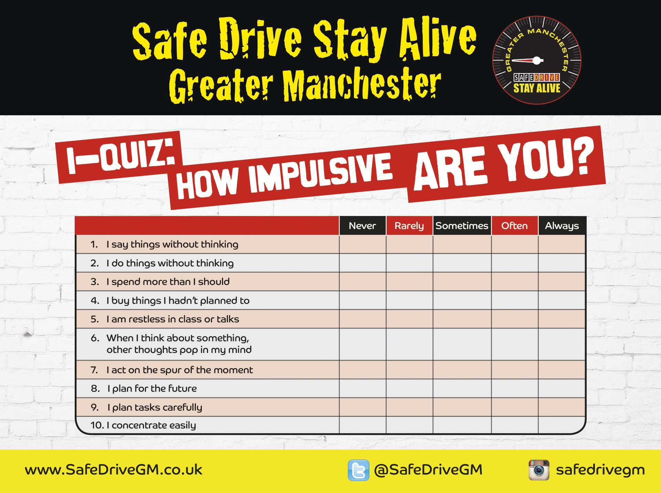
Notes:
Tell students: Now we’re going to measure how impulsive you are. Fill in the i-quiz on your worksheet. For each question tick a box to show how often you do these things.
Teacher notes
This is a mini Impulsivity quiz so that young people can measure how impulsive they are.
It’s only a few questions from the whole quiz, so people don’t get an official score but it highlights that they are impulsive.

Slide 5
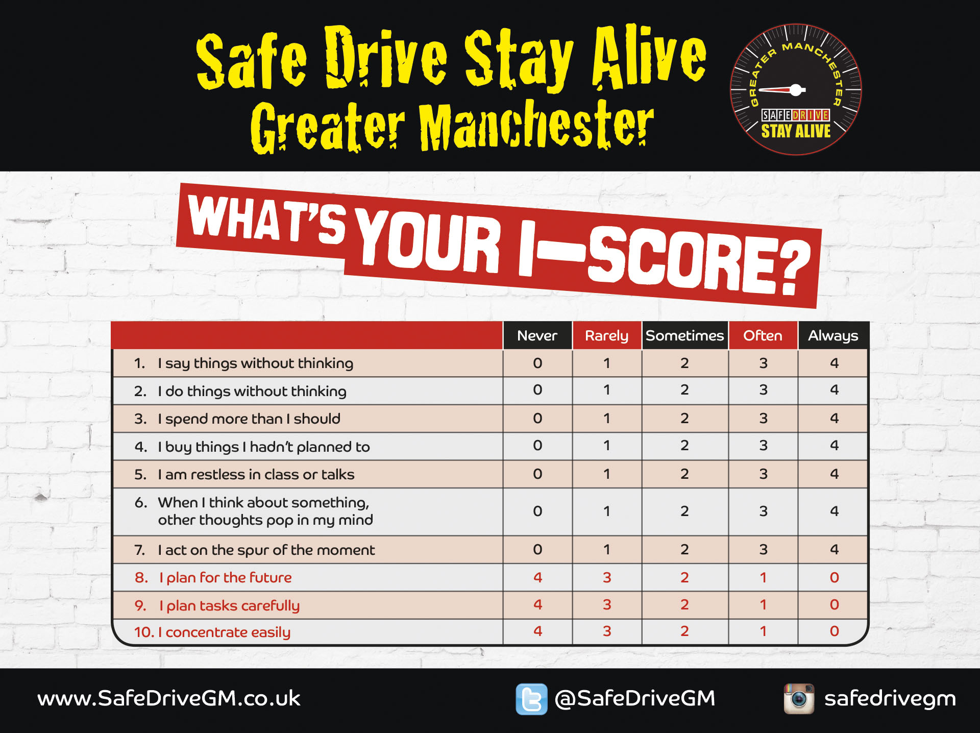
Notes:
Tell students how to score the quiz:
Each question gets a score: either 0, 1, 2, 3 or 4.
Questions 8, 9 and 10 have a different scoring system.
Shout-out activity:
Add up your scores – what do you have? Does anybody have zero?.
This is only a few questions from a longer questionnaire, so it’s a bit of fun rather than an official score. But it shows that you all have some impulsivity.
If you have a low score this doesn’t mean that you are not impulsive – these are only a small number of the questions that measure impulsivity so you might be more impulsive in different ways.

Slide 6

Notes:
Ask students: Now you know that you can be impulsive, what do you do that is impulsive?
Teacher notes
This is a shout-out activity to get students to identify what they do that is impulsive.
Examples include: impulse purchases while shopping; sending a text without really thinking it through.

Slide 7

Notes:
Tell students:
I-triggers - or impulsivity triggers – are things that make you more impulsive.
They can be situations, people, or events. For example, a really common one is alcohol – people are more impulsive after a few drinks.
Shout-out activity: What are your i-triggers?
Examples might be feeling tired, when you’re with friends, when you’re in a good mood (or a bad mood), when it’s sunny, when you’re with somebody you fancy.

Slide 8

Notes:
Tell students:
People also behave impulsively on the road, as a pedestrian, cyclist, as a bike or scooter rider, and as a driver and passenger.
We’re going to look at being impulsive when you’re a driver or passenger
Brief shout-out activity: How do people behave impulsively as a driver or passenger?
Teacher notes: examples include using a mobile, overtaking where it’s not safe, speeding, messing about in the car, not wearing a seat belt, racing another driver.

Slide 9
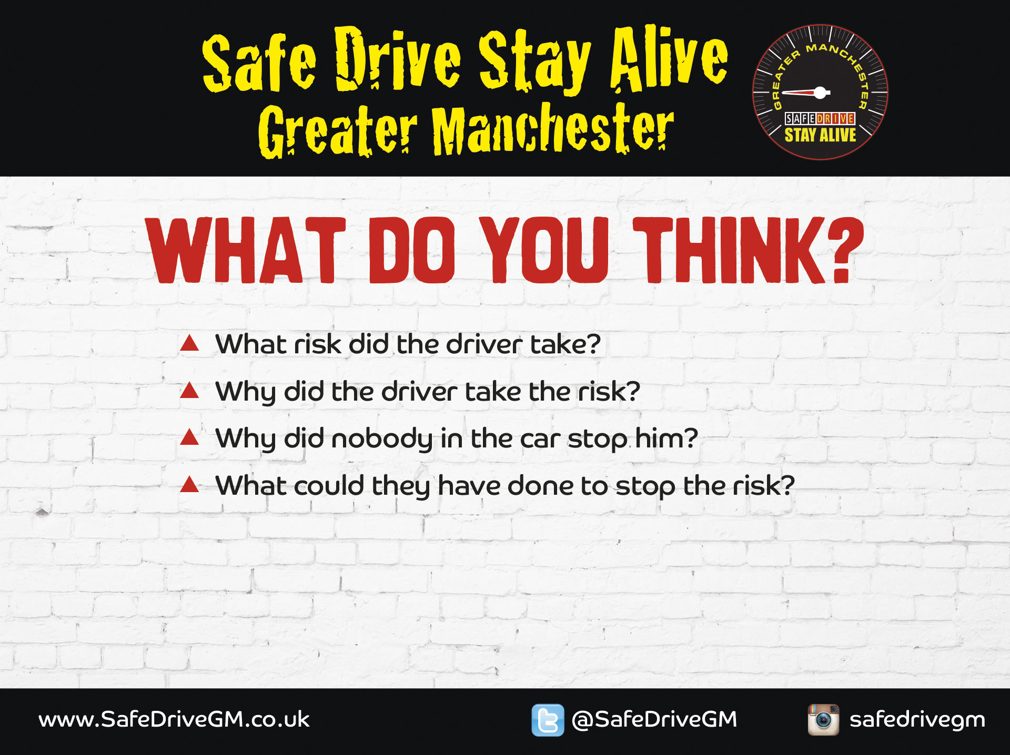
Notes:
This is a group activity on the case study on the worksheet – Pete and his friends.
Break the young people into small groups (about six) and ask each group to nominate a spokesperson to feed back.
Tell students:
Read the case study about Pete. Then as a group dome up with answers to these questions.
You have 10 minutes, and your spokesperson can feed back what you decided.
Ask for feedback from the groups.

Slide 10
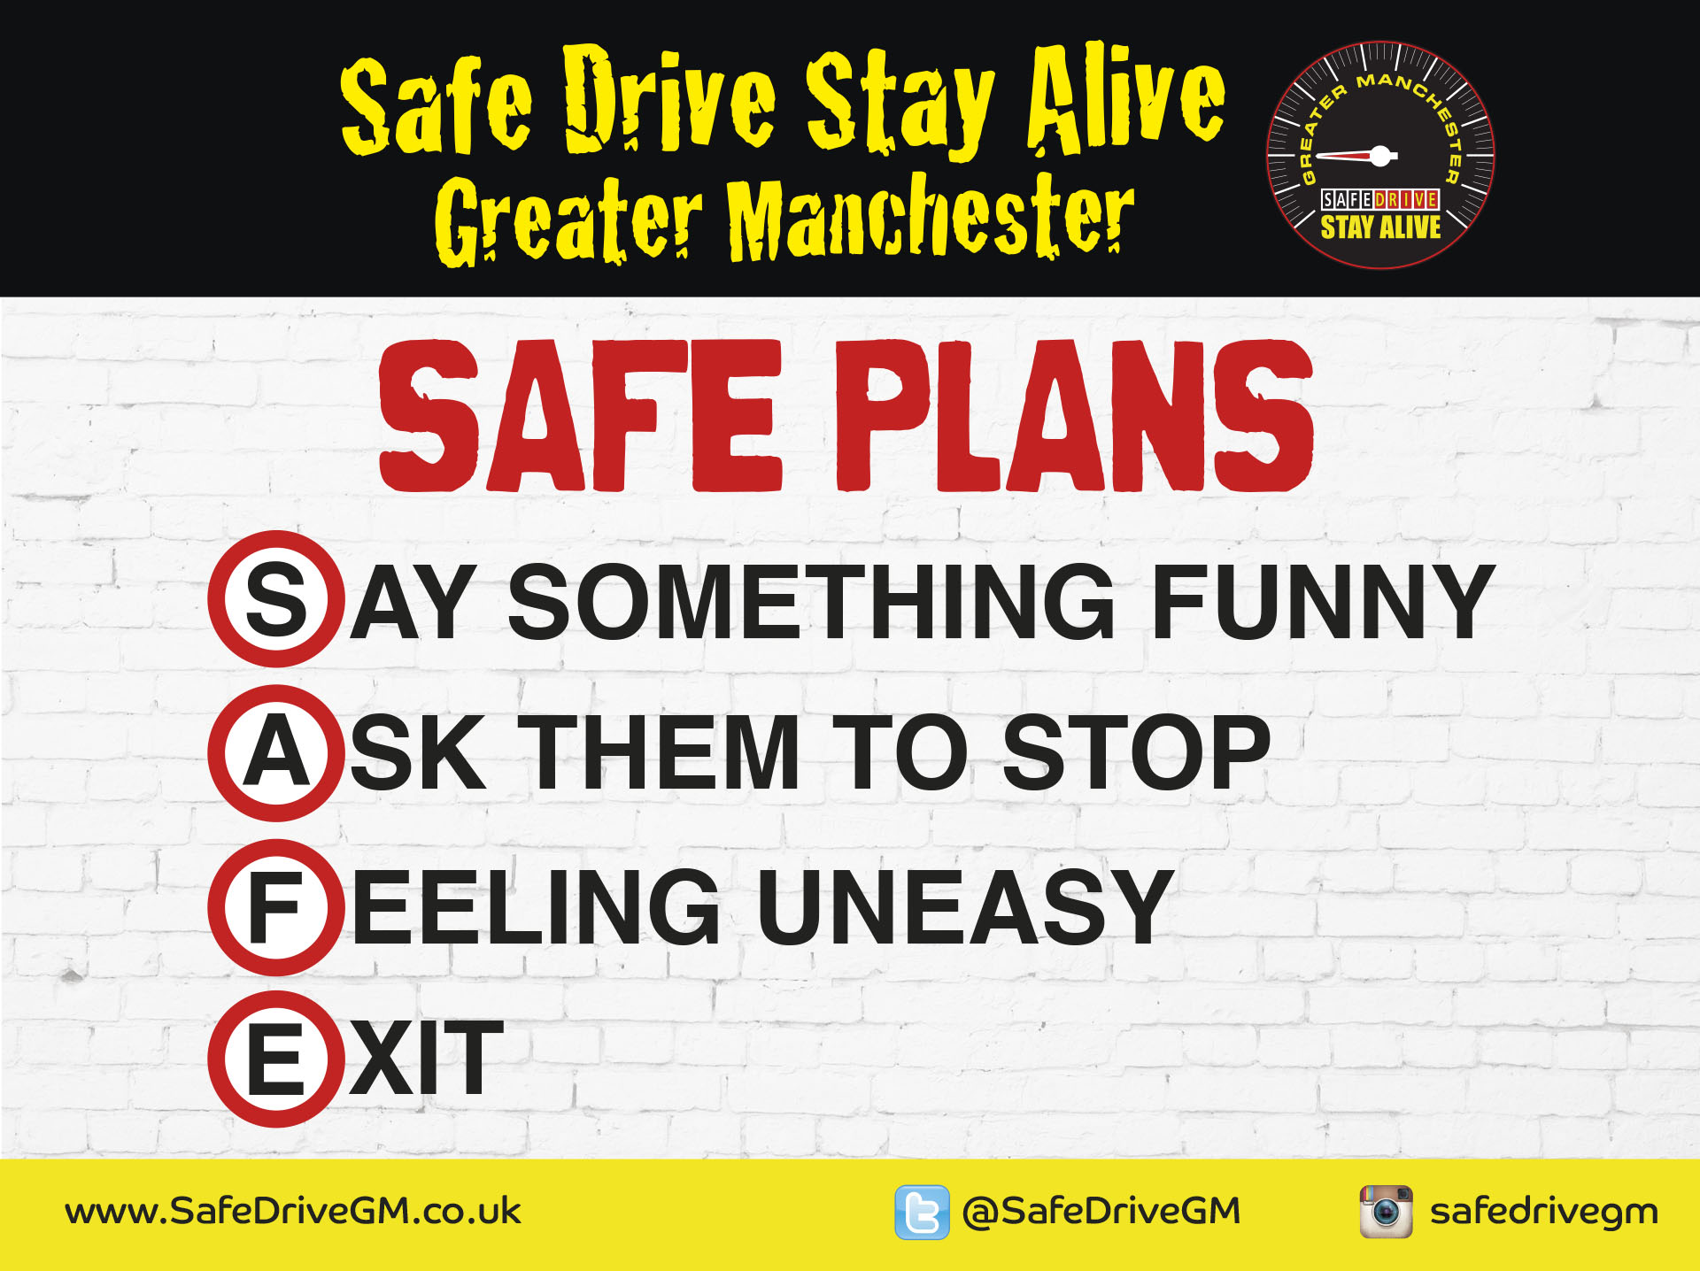
Notes:
Tell students:
Now we’re going to look at ways you can make it easier to protect yourself and other people if the driver or the passengers are putting you at risk.
A SAFE plan is a four-stage action plan that you can use to get out of a risky situation in a car and something is happening that is making you feel unsafe. It stops a small risk becoming a big risk.
The speech bubble appears on the next click.
Tell students: If the situation is very risky or you are in immediate danger go straight to E – exit the situation.

Slide 11
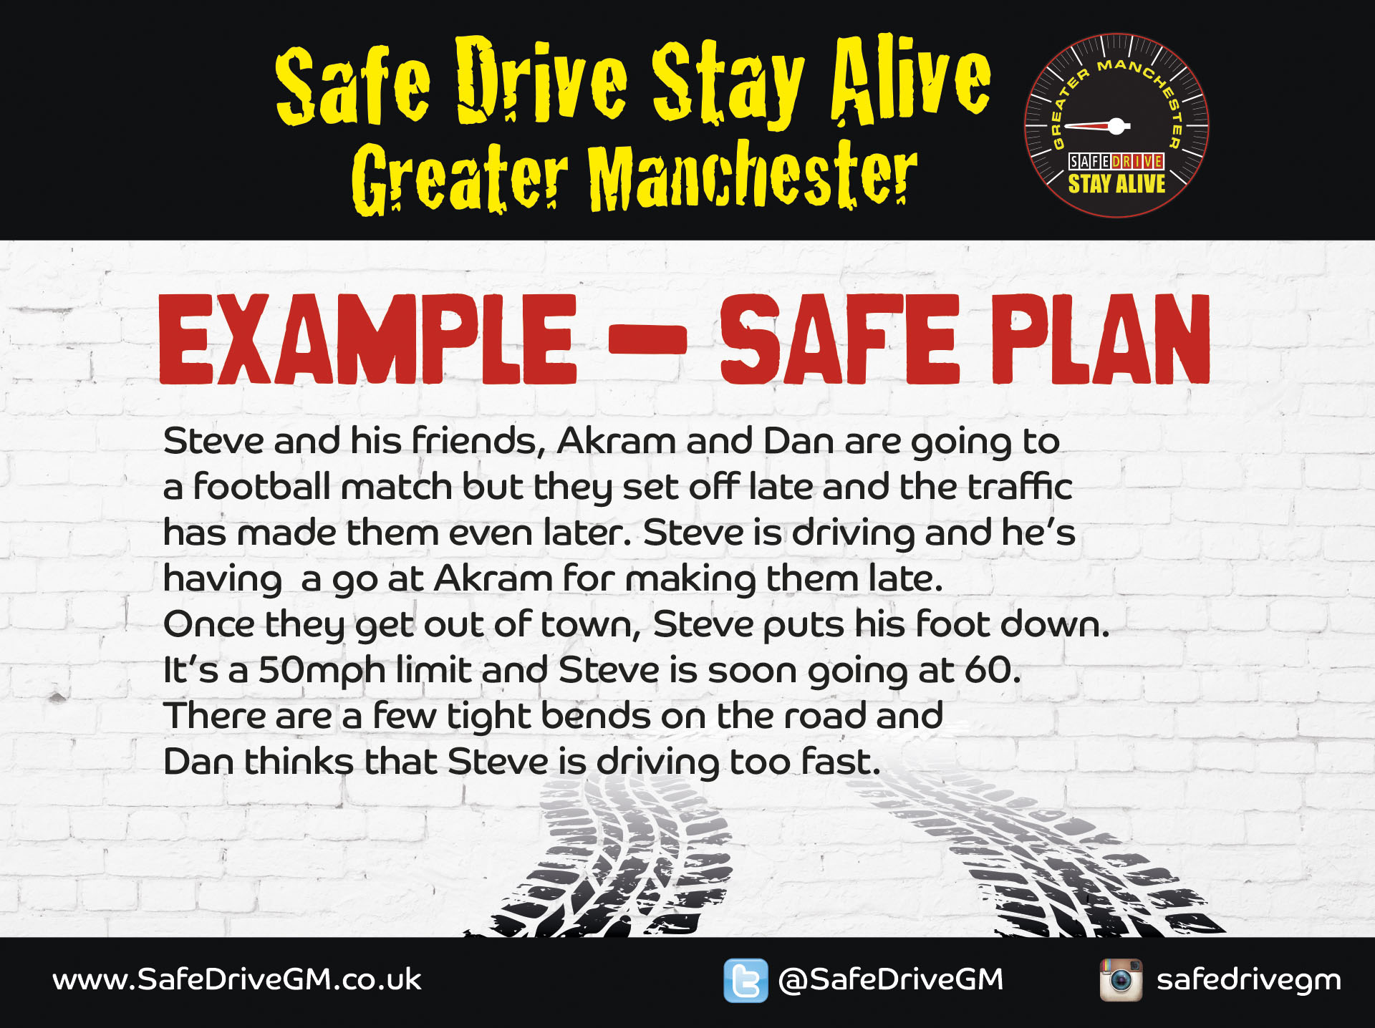
Notes:
Tell students: We’re going to look at a SAFE plan to get out of a risky situation.
Read out the example.
Click onto the next slide to show the SAFE plan.

Slide 12

Notes:
Tell students: This is an example of how Dan would use his action plan when he feels unsafe.
(Click to make the next speech bubbles appear.)
Say something funny: To reduce the chance a small risk will become a big one, you can try a lighthearted approach first. Dan says: Are the police on your tail? I didn’t realise we were in a getaway car.
Ask them to stop: Be more direct and ask them to stop what they are doing. Dan says: Can you stop overtaking, we’ve still got plenty of time.
Feeling uneasy. Say how you feel. Dan says: Your driving is making me feel really uncomfortable. You’re going too fast.
Exit: Get yourself out of the situation or the vehicle as safely as possible. Dan says: I don’t want to be in the car if you’re going to drive like this. Please can you pull over somewhere safe and let me get out.

Slide 13
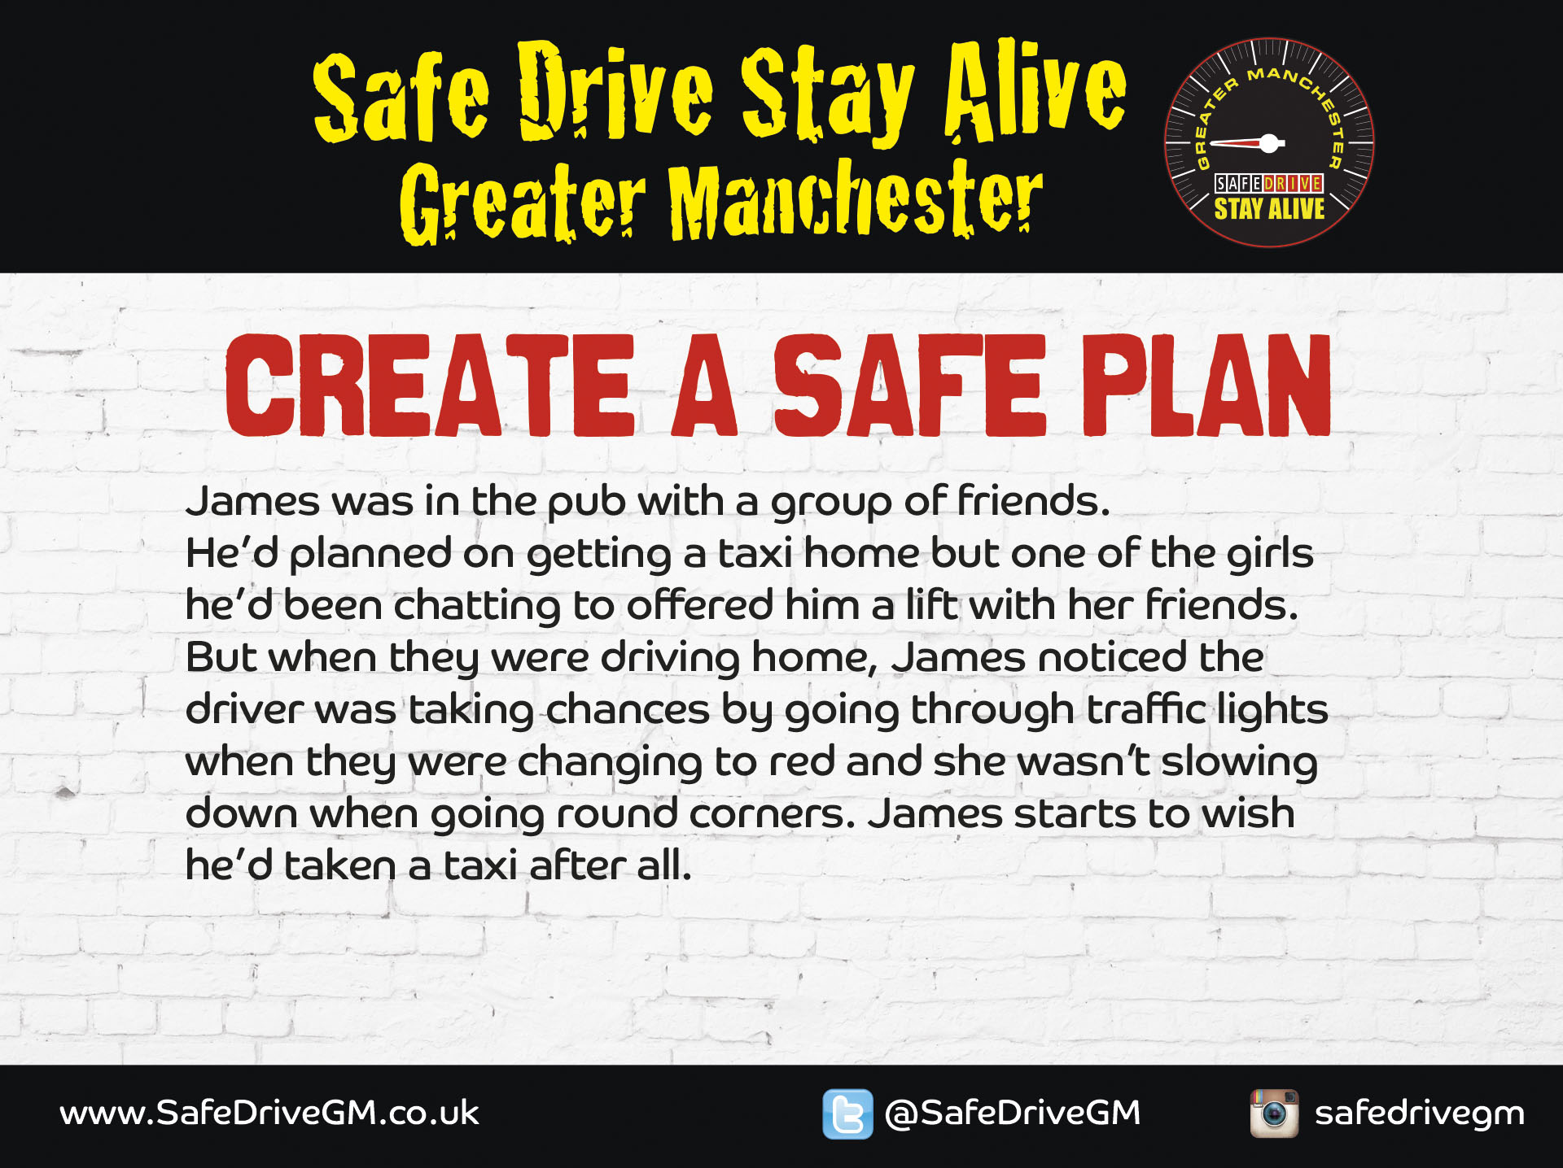
Notes:
This is a small-group activity to create a SAFE plan for James.
Tell students: Imagine you are James. You realise that the driver is taking too many risks. As a group, come up with a SAFE plan.
Task takes 10 minutes.
Get feedback from the groups and provide suggestions of other things that could go into a SAFE plan.
Tell students: If James feels he is in immediate danger – like if he starts to think that the driver is drunk – he should Exit straight away.

Slide 14
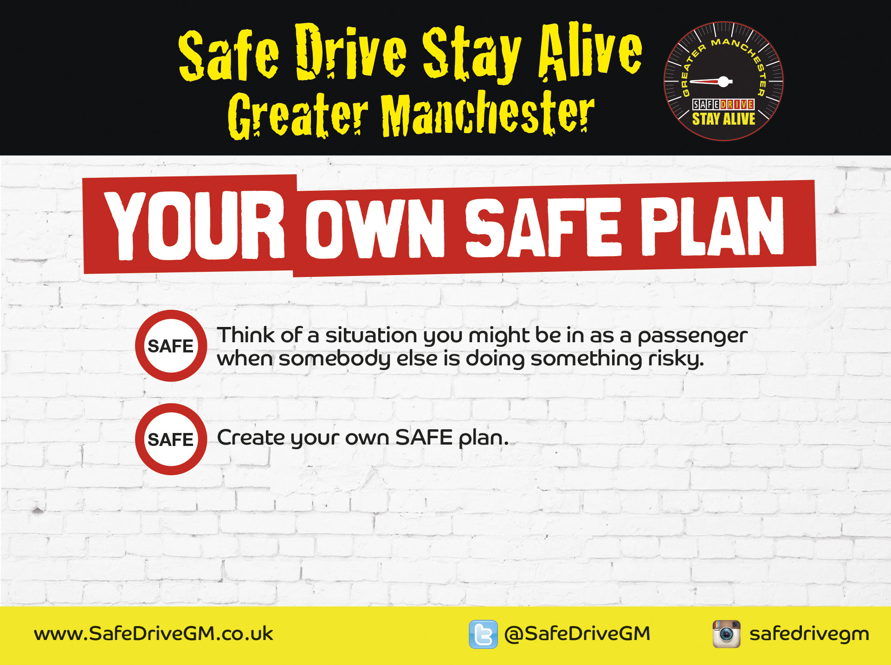
Notes:
This is an individual activity in which students think of a risky situation that they might be in and create their own SAFE plan.
Tell students:
Now I want you individually to think of a risky situation that you could be in when you are a passenger.
Come up with your own SAFE plan of what you will say to get you out of the situation.
Allow around 5 minutes then ask for feedback.
Tell students: You should always have enough money for a taxi home or you should be able to phone somebody you trust to come and get you.

Slide 15
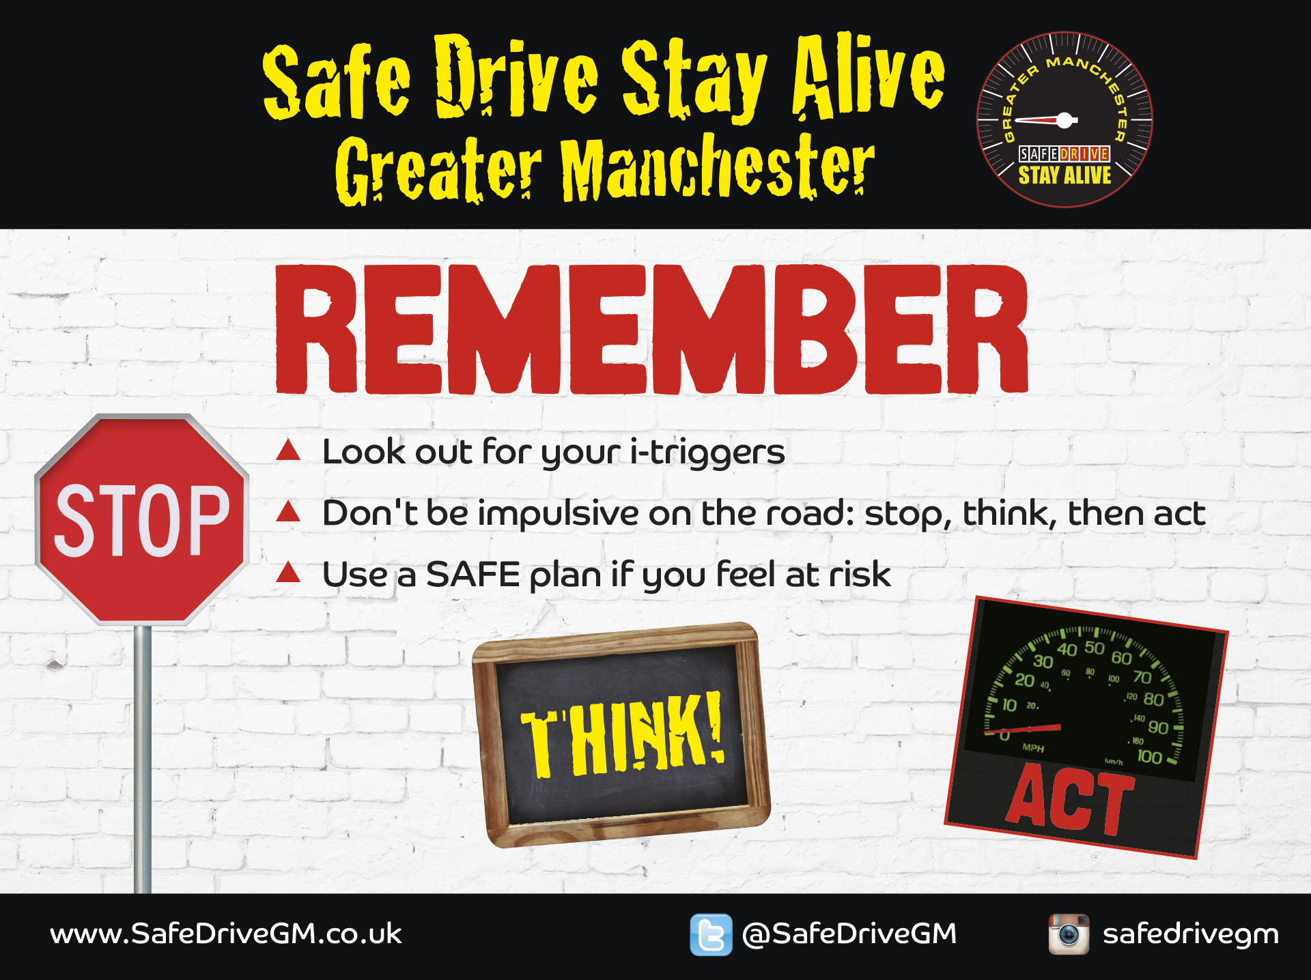
Notes:
Finish the session by summarising the main points.
Everybody acts impulsively sometimes but being implusive can cause you to make bad choices.
Look out for your i-triggers.
Don’t be impulsive on the road – Stop, Think and Act.
Use a SAFE plan if you feel at risk.

