Slide 1
Notes:
This is an optional module.
It should be delivered after the two core modules: impulsivity and pressure.
Use these PowerPoint slides in conjunction with the resource sheet, which provides a module plan and a worksheet for students to use.
The module lasts 30 minutes.

Slide 2
Notes:
Tell students:
This slide highlights why drink driving is a problem that affects young people.
There are around 1,775 deaths on the road each year. Around 14% of these are due to drink driving. That is 240 people dying because of alcohol and 8,030 who are injured or seriously injured.
Most drink drive deaths and injuries happen at the weekend, and three quarters of people killed or injured are male.
Tutor notes
These statistics are for 2013 – the most recent drink-drive statistics available.

Slide 3
Notes:
Tell students:
Now that the police have drug screening tests, if you drive after taking drugs your chances of being caught are much much higher.
The legal limit for drugs is very low – so even if you took drugs a few days before you could still be over the drug drive limit.
What happens if you get caught? The same as for alcohol – banned for at least a year, you have a criminal record, and you can have a huge fine and you can be sent to jail.
Tutor notes
The statistics are from the Department for Transport (2015).

Slide 4
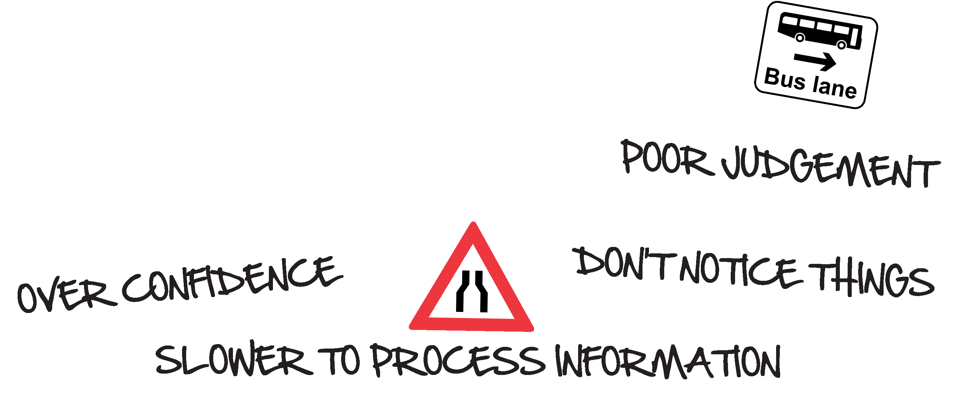
Notes:
Tutor notes
This slide is to highlight that people take alcohol and drugs BECAUSE of the physical and psychological effects they have and so they affect driving too.
Ask students: Why do people drink alcohol? What effects does it have on them?
Click for the next text to appear
Ask students: If that’s the effect it has on people, what do you think it does to your driving?
The next click reveals the answers.
Tell students: this means that if you drink-drive you are a risk to yourself and others.

Slide 5
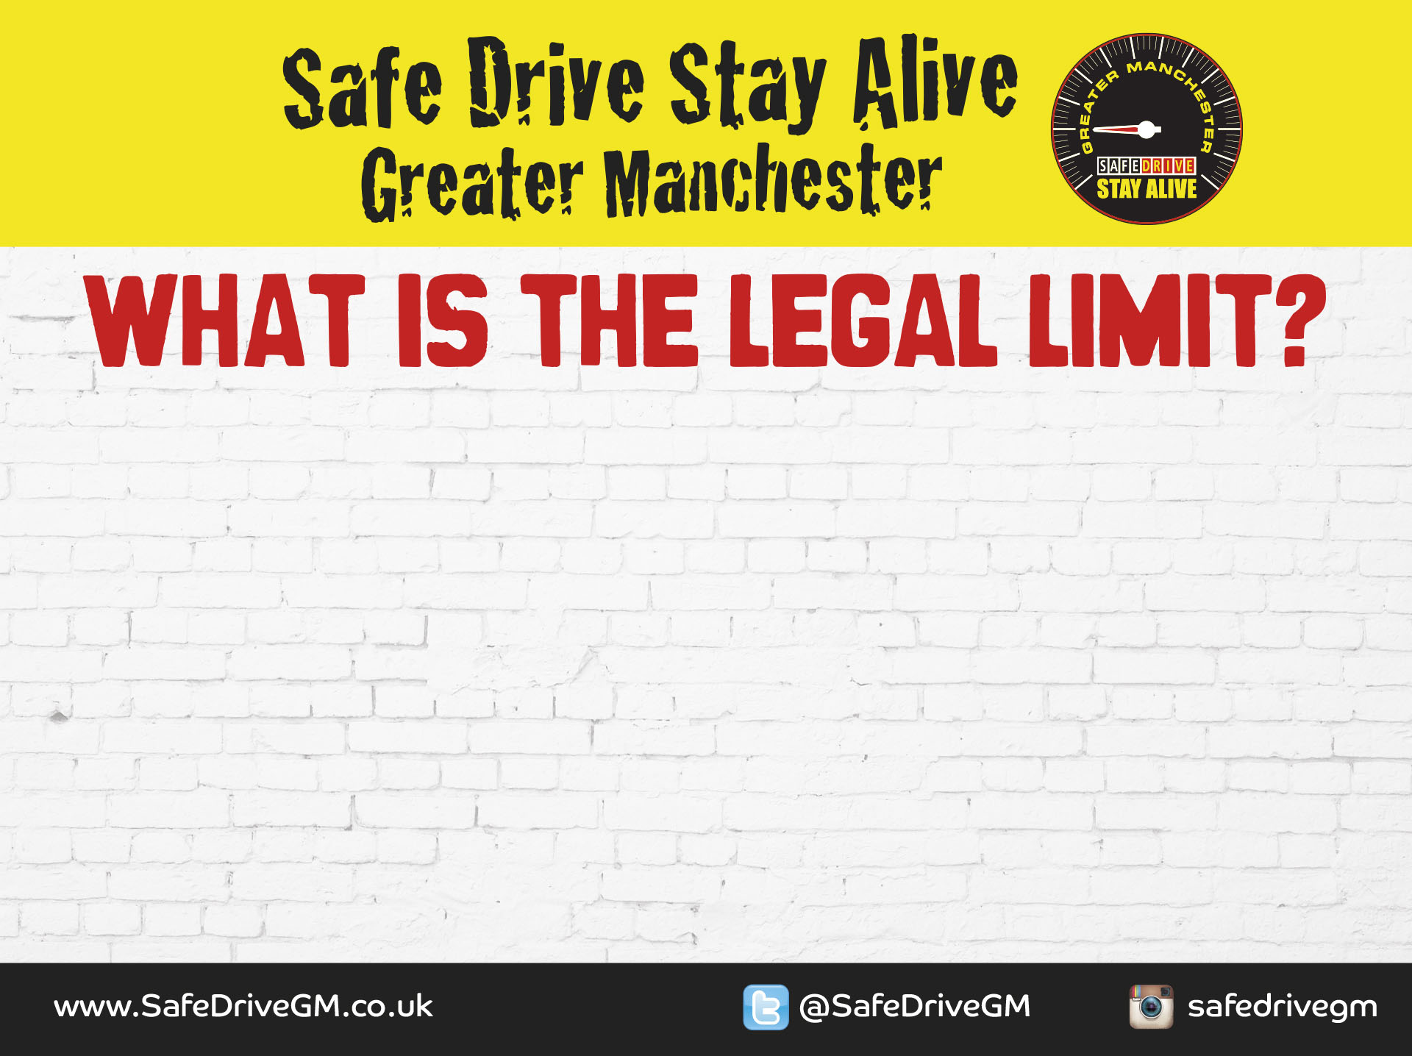
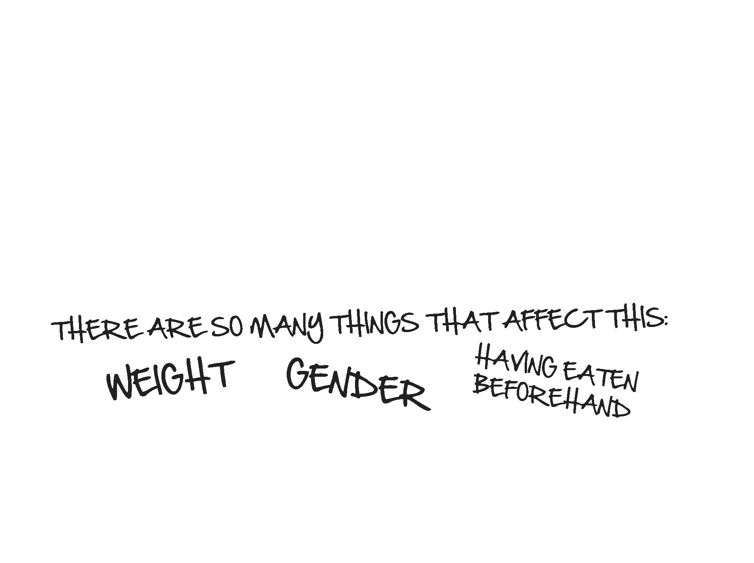
Notes:
Tutor notes
This slide is to make sure students know what the legal drink-drive limit is and to know when they are safe to drive after drinking.
Ask students: What is the legal drink-drive limit?
Tell students: 80 milligrammes of alcohol per 100 millilitres of blood. This is approximately 4 units of alcohol, where 1 unit is:
1/2 pint of weak lager.
1/3 pint of strong lager.
1 shot of spirits
1 very small glass of wine.
Ask students: How long does a unit stay in your blood?
Text appears on click
Tell students: There are so many things that affect how long alcohol stays in your blood it’s impossible to know for sure.
Text appears on click
Tell students: The only safe decision is not to drink at all if you are driving. You also need to be careful that you are not still over the limit the next morning. It takes about an hour to be free of each unit of alcohol from when you STOP drinking.

Slide 6
Notes:
Tutor notes: This is a small-group activity to discuss the Dan case study. It lasts around 10 minutes.
Tell students: In your groups, read the case study and answer the questions. After about 5 minutes I’ll ask each group to feed back what you discussed.

Slide 7
Notes:
Tutor notes: This is an individual worksheet activity. Allow around 10 minutes.
Tell students: On your worksheet you can see two sets of boxes. On the left side is a list of situations and on the right side is a list of actions. For each situation, draw an arrow to the action you will take. You can pick more than one action for each situation and you don’t need to use all the actions. There is also a box for you to write in your own ideas of the actions you will take.
Ask students: What did you put?

Slide 8
Notes:
Finish the session by summarising the main points.
Driving under the influence of drugs or alcohol is illegal and increases your risk of crashing.
You can still be over the limit the morning after.
Don’t drive after taking drugs or alcohol and don’t let your friends do so.
Don’t take a lift from somebody who has taken drugs or drunk alcohol.

